Slide 1



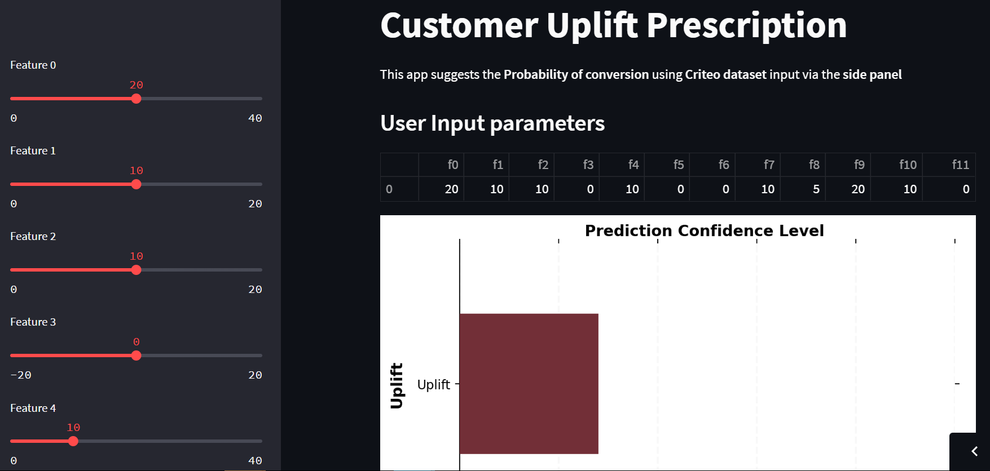




DEPLOYMENT SOLUTION ARCHITECTURE
User
Data Scientist
User
Data Scientist
http://go.criteo.net/criteo-research-uplift-v2.1.csv.gz
TRAIN
ACCESS WEB APP
model.py
https://share.streamlit.io/mudassarmshaikh/upliftmodel/main/app.py
uplift_model.joblib
api.py
app.py
https://mudassarshaikh.pythonanywhere.com/predict

Slide 2





api.py
https://mudassarshaikh.pythonanywhere.com/predict
model.py
uplift_model.joblib
https://share.streamlit.io/mudassarmshaikh/upliftmodel/main/app.py
app.py

